Slide 1
Text & audio sentiment analyzer
Prepared by: Prachi Mehta (202318008)
Organization: Elite Technocrats
Supervisor: Nidhi Rathod

Slide 2
Introduction
Sentiment analysis is the process of identifying and categorizing emotions, opinions, or attitudes expressed in text or audio data.
As people increasingly share feedback through reviews, social media, and voice messages, it’s important to understand this data to improve services, make better business decisions, and enhance user experience.
This project presents a web application that can analyze both text and audio inputs for sentiment, providing results in real-time using machine learning models and lexicon-based methods.

Slide 3
objective
Most existing sentiment analysis systems focus only on text data, leaving audio feedback largely unexplored and underutilized.
Direct audio sentiment analysis requires complex, resource-heavy deep learning models, making them difficult to implement in small projects or real-time applications.
There is a need for a lightweight, efficient, and easy-to-use integrated system that can analyze both text and audio inputs for sentiment in a fast and accurate manner.

Slide 4
Tools & Technologies Used
Python
Natural Language Processing (NLP) & Sentiment Analysis:
VADER Sentiment Analysis
NLTK
Machine Learning:
Scikit-learn (Naïve Bayes & Logistic Regression)
Audio Processing:
Librosa (Audio Feature Extraction)
Front-end:
Flask

Slide 5
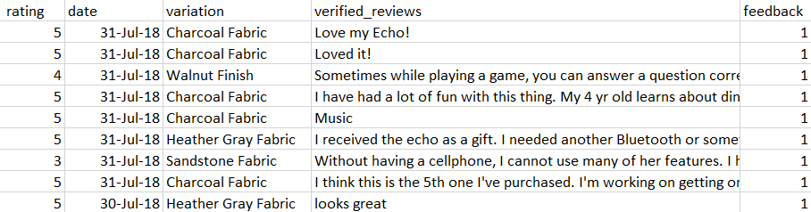
Data overview
Text Sentiment Dataset: “amazon_alexa” From Kaggle
Audio Sentiment Dataset:
Custom audio clips generated using Google Text-to-Speech (gTTS).
https://drive.google.com/drive/folders/1jL2kypdz62PGRmjz6H9qnPtCeve3Q3NF?usp=drive_link

Slide 6
methodology
Text Sentiment Analysis:
Data Collection
Sentiment Classification
Preprocessing
Tokenization, stopwords removal, cleaning
Naïve Bayes
Logistic Regression
Amazon Alexa dataset
Feature Extraction
TF-IDF Vectorization
VADER Sentiment Analysis

Slide 7
methodology
Audio Sentiment Analysis:
Data Collection
Sentiment Classification
Preprocessing
Librosa
Naïve Bayes
Logistic Regression
Custom audio clips created using gTTS
Audio Transcription
Convert audio to text using SpeechRecognition
Feature Extraction
MFCC Extraction using Librosa
VADER Sentiment Analysis

Slide 8
Results & Evaluation
Achieved 89% accuracy with Naïve Bayes and 94% with Logistic Regression for text sentiment classification.
Audio clips were converted to text using Google Speech Recognition, then passed through the same text sentiment analysis pipeline.
Model performance was evaluated using Accuracy Score as the primary metric.

Slide 9
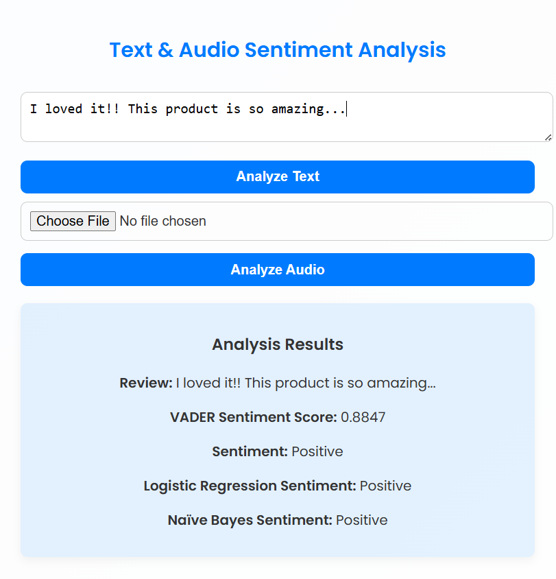
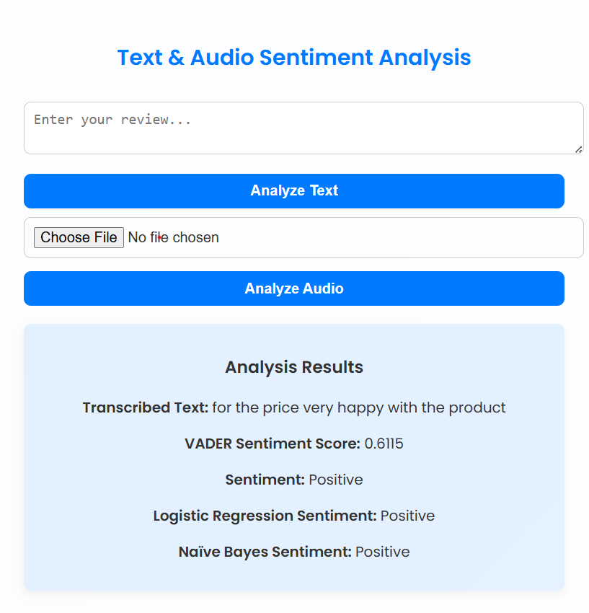
Final output

Slide 10
conclusion
Successfully developed a system for text and audio sentiment analysis using machine learning and NLP techniques.
Incorporated VADER sentiment analysis, Naïve Bayes, and Logistic Regression models for effective classification.
Enabled a simple Flask-based web interface for users to input text or audio and receive sentiment predictions instantly.

Slide 11
Future scope
Integrate deep learning models like LSTM or CNN for improved accuracy in audio sentiment classification.
Expand the dataset with real-world conversational audio samples for better model generalization.
Include a microphone for live audio input to enable real-time sentiment analysis.
Develop a mobile or desktop application for easier access and real-time sentiment analysis.

Slide 12
references
Text sentiment dataset: https://www.kaggle.com/datasets/khaledsayedaaaaa/amazon-alexa
Sentiment classification using ML: https://aclanthology.org/W02-1011.pdf
Multimodel sentiment Analysis: https://arxiv.org/pdf/1803.07427

Slide 13
Thank you…

